Slide 1

Introduction To Distributed Systems
Dr. Zainab Hassan Ali
Lecturer at the Department of Embedded Network and Technology, Faculty of Artificial Intelligence, Kafrelsheikh University
Email: zainabhassan@ai.kfs.edu.eg

Slide 2
In This Chapter
Parallel Computing.
Distributed Computing.
Communication in DS: Remote Procedure Call.
Distributed System architecture: Overview
Distributed System architecture: Styles.

Slide 3
PART 2

Slide 4
CHAPTER 2 Parallel
&
Distributed Systems

Slide 5
Cloud Computing: Classification
Cloud Computing Classification
Administration
(shared information)
Process Execution
Data Type
C/S Model
c/s is a simple model
Parallel
Distributed
Data Intensive
Data Non-intensive
Support transparency
Hide the distributed nature of system
Parallelism
High Performance
Fault tolerance
Many cloud applications are data-intensive and use a number of instances that run concurrently. Transaction processing systems, such as Web based services, represent a large class of applications hosted by computing clouds; such applications run multiple instances of the service and require reliable and in-order delivery of messages.
Fully pipeline
High Availability
Data Recovery
High Resource Utilization

Slide 6
Parallel Computing Architecture:
Parallel Computing levels
Bit-level parallelism.
Instruction-level parallelism.
Data / loop parallelism
Task parallelism
The number of bits processed per clock cycle, often called a word size, has
increased gradually from 4-bit processors to 8-bit, 16-bit, 32-bit, and, since 2004, 64-bit.
This has reduced the number of instructions required to process larger operands and allowed a significant performance improvement.
The computers use multi-stage processing pipelines to speed up execution.
Once an n-stage pipeline is full, an instruction is completed at every clock cycle.
A “classic” pipeline of a Reduced Instruction Set Computing (RISC) architecture consists of five stages2: instruction fetch, instruction decode, instruction execution, memory access, and write back.
A Complex Instruction Set Computing (CISC) architecture could have a much large number of pipelines stages.
The program loops can be processed in parallel.
A widely used type of task parallelism is the Same Program Multiple Data (SPMD) paradigm. As the name suggests, individual processors run the same program but on different segments of the input data. Data dependencies cause different flows of control in individual tasks.

Slide 7
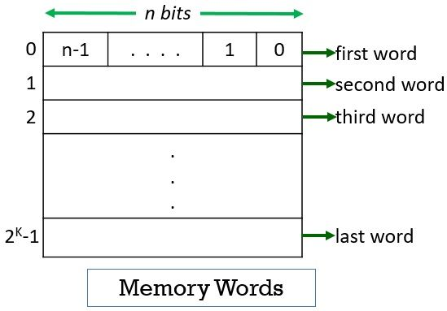
Parallel Computing Architecture:
Word Size in the bit-level parallelism

Slide 8
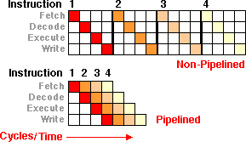
Parallel Computing Architecture:
Pipelined vs. Non-pipelined operations

Slide 9
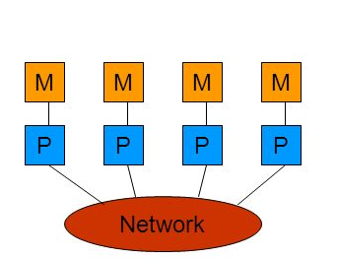
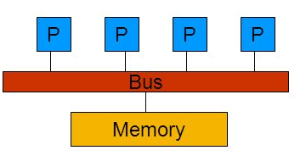
Distributed System: Types
*Parallel Computing:
Each node has its own memory (Memory is private)
1
Distributed Memory
Single memory shared between each nodes
2
Shared Memory

Slide 10
Distributed System
A distributed system is a collection of autonomous computers that are connected through a network and distribution software called middleware, which enables computers to coordinate their activities and to share the resources of the system. A distributed system’s users perceive the system as a single integrated computing facility
For example, distributed file systems and network file systems have been used for user convenience and to improve reliability and functionality of file systems for many years. Modern operating systems allow a user to mount a remote file system and access it the same way a local file system is accessed, yet with a performance penalty due to larger communication costs. The remote procedure call (RPC) supports inter-process communication and allows a procedure on a system to invoke a procedure running in a different address space, possibly on a remote system

Slide 11
Distributed System: Types
Distributed System Types
High Performance Distributed Computing Systems
Distributed Information Systems
Distributed Systems for Pervasive Services
Computational Process
Data Storage and Query
Ubiquitous Service
Grid Computing (blockchain)
Cluster Computing (Hadoop)
Transaction
Middleware (RPC, MoM)
Mobile Computing
Sensor Networks

Slide 12
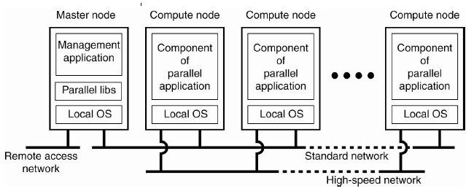
Distributed System: Types
*Cluster Computing:
The cluster computing is mainly for parallel programming and homogeneous platforms.

Slide 13
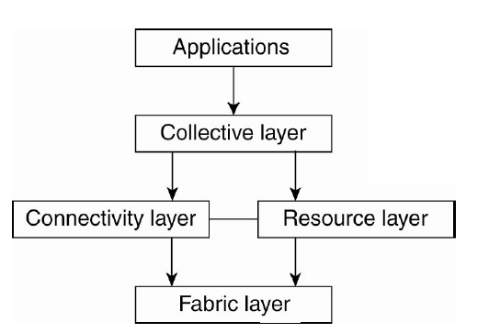
Distributed System: Types
*Grid Computing:
Fabric provides interfaces to local resources.
Connectivity consists of communication protocols for supporting
grid transactions that may use multiple resources
Resource responsible for managing a single resource; use info from connectivity layer to call fabric layer.
Collective handles access to multiple resources, typically consisting of services for discovering and allocating resources

Slide 14
Process: Overview

Slide 15



Process: Overview
A modern computer operating system usually segregates virtual memory into “user space” and “kernel space”. Primarily, this separation serves to provide memory protection and hardware protection from malicious or errant software behaviour.
* Memory protection means control the memory access right on the computer.
*On the Operating System:-
An operating system executes a variety of programs:
Batch system – jobs (Kernel space).
Time-shared systems – user programs or tasks (User space).

Slide 16
Process: Overview – Cont.
*Process
A program in execution; process execution must progress in sequential fashion.
*Characteristics
Program is passive entity stored on disk (executable file), process is active.
Program becomes process when executable file loaded into memory.
Execution of program started via GUI mouse clicks, command line entry of its name, etc
One program can be several processes
Consider multiple users executing the same program
Q: What is the difference between “Program” and “Process”?

Slide 17
Process: Overview - Cont.
Scheduler Algorithms
OS
FCFS
SJF
Priority
Bootstrap loader
Kernel
OS.
P₀
CPU
Processes
(Active entities)
P₁
Dispatcher
Input Queue
loader
Ready Queue
P₂
…..
Programs (Passive entities)
P_{n}
RAM

Slide 18
Process: Overview - Cont.
* Program vs. Process
Program:
Series of commands
Instructions only (usually not data)
Stored on disk, copied into memory.
Also called software
Includes shell scripts, batch files
Process:
Variables point to instructions + data
Loaded in memory
- Context contains all process state info.
- Stored in Process Control Block.
Also called task (or job for batch processes)

Slide 19
Process: Overview - Cont.
* Process State:-
Process State
New
Running
Runnable
Ready
Waiting ()
Blocked
Read ()
Suspended
e.g., swapped to virtual memory
Terminated

Slide 20
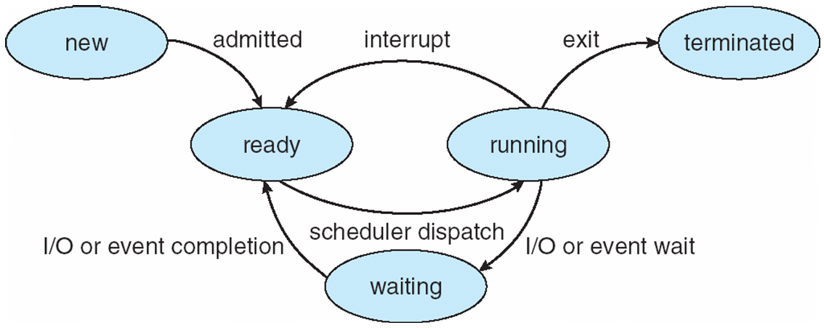
Process: Overview - Cont.
* Process State:-

Slide 21
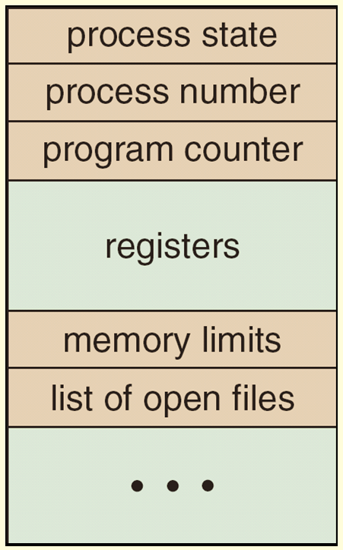
Process: Overview - Cont.
* Process Control Block (PCB):-
Information associated with each process also called Task Control Block/ Process Image.
Process state – running, waiting, etc
Program counter – location of instruction to next execute
CPU registers – contents of all process-centric registers
CPU scheduling information- priorities, scheduling queue pointers
Memory-management information – memory allocated to the process
I/O status information – I/O devices allocated to process, list of open files

Slide 22
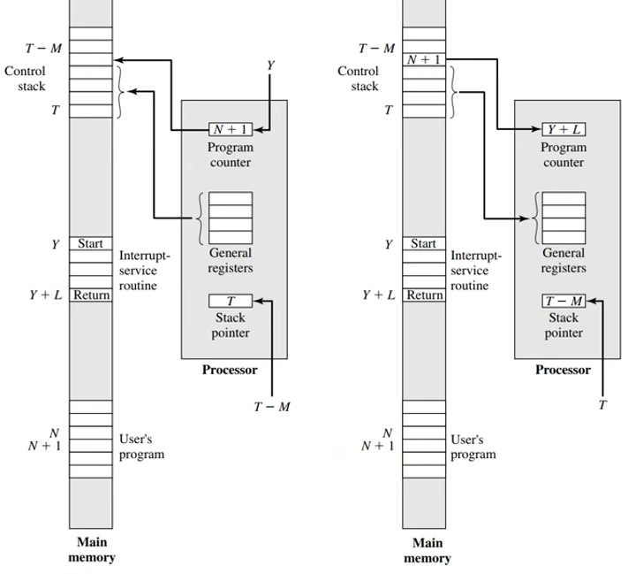
Process: Overview - Cont.

Slide 23
Threads: Overview

Slide 24
Thread: overview.
Thread:-
Thread is a lightweight program.
All threads use the same address space (is a bottleneck)
Subdivides work of the process
Threads are managed by the process
Reduces high overhead for creating processes and context switching
Java was designed to write thread-based programs

Slide 25
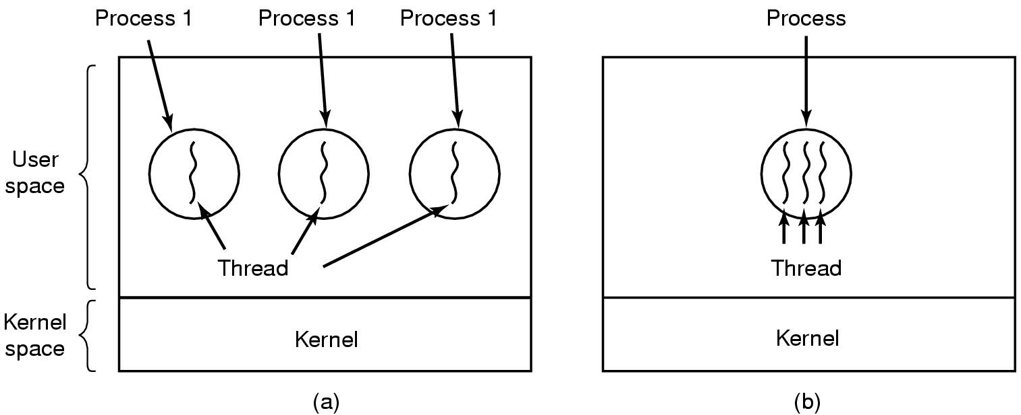
Thread: overview – Cont.
(a) Three processes each with one thread
(b) One process with three threads

Slide 26
Thread: overview.
*Thread usage:
Servers (database, mail, print, etc.)
- One thread per client request.
Network server
- One thread per connection.
Time-sharing
- One thread per user.
Real-time factory control
- One thread per device.

Slide 27
Remote Procedure Call (RPC)

Slide 28
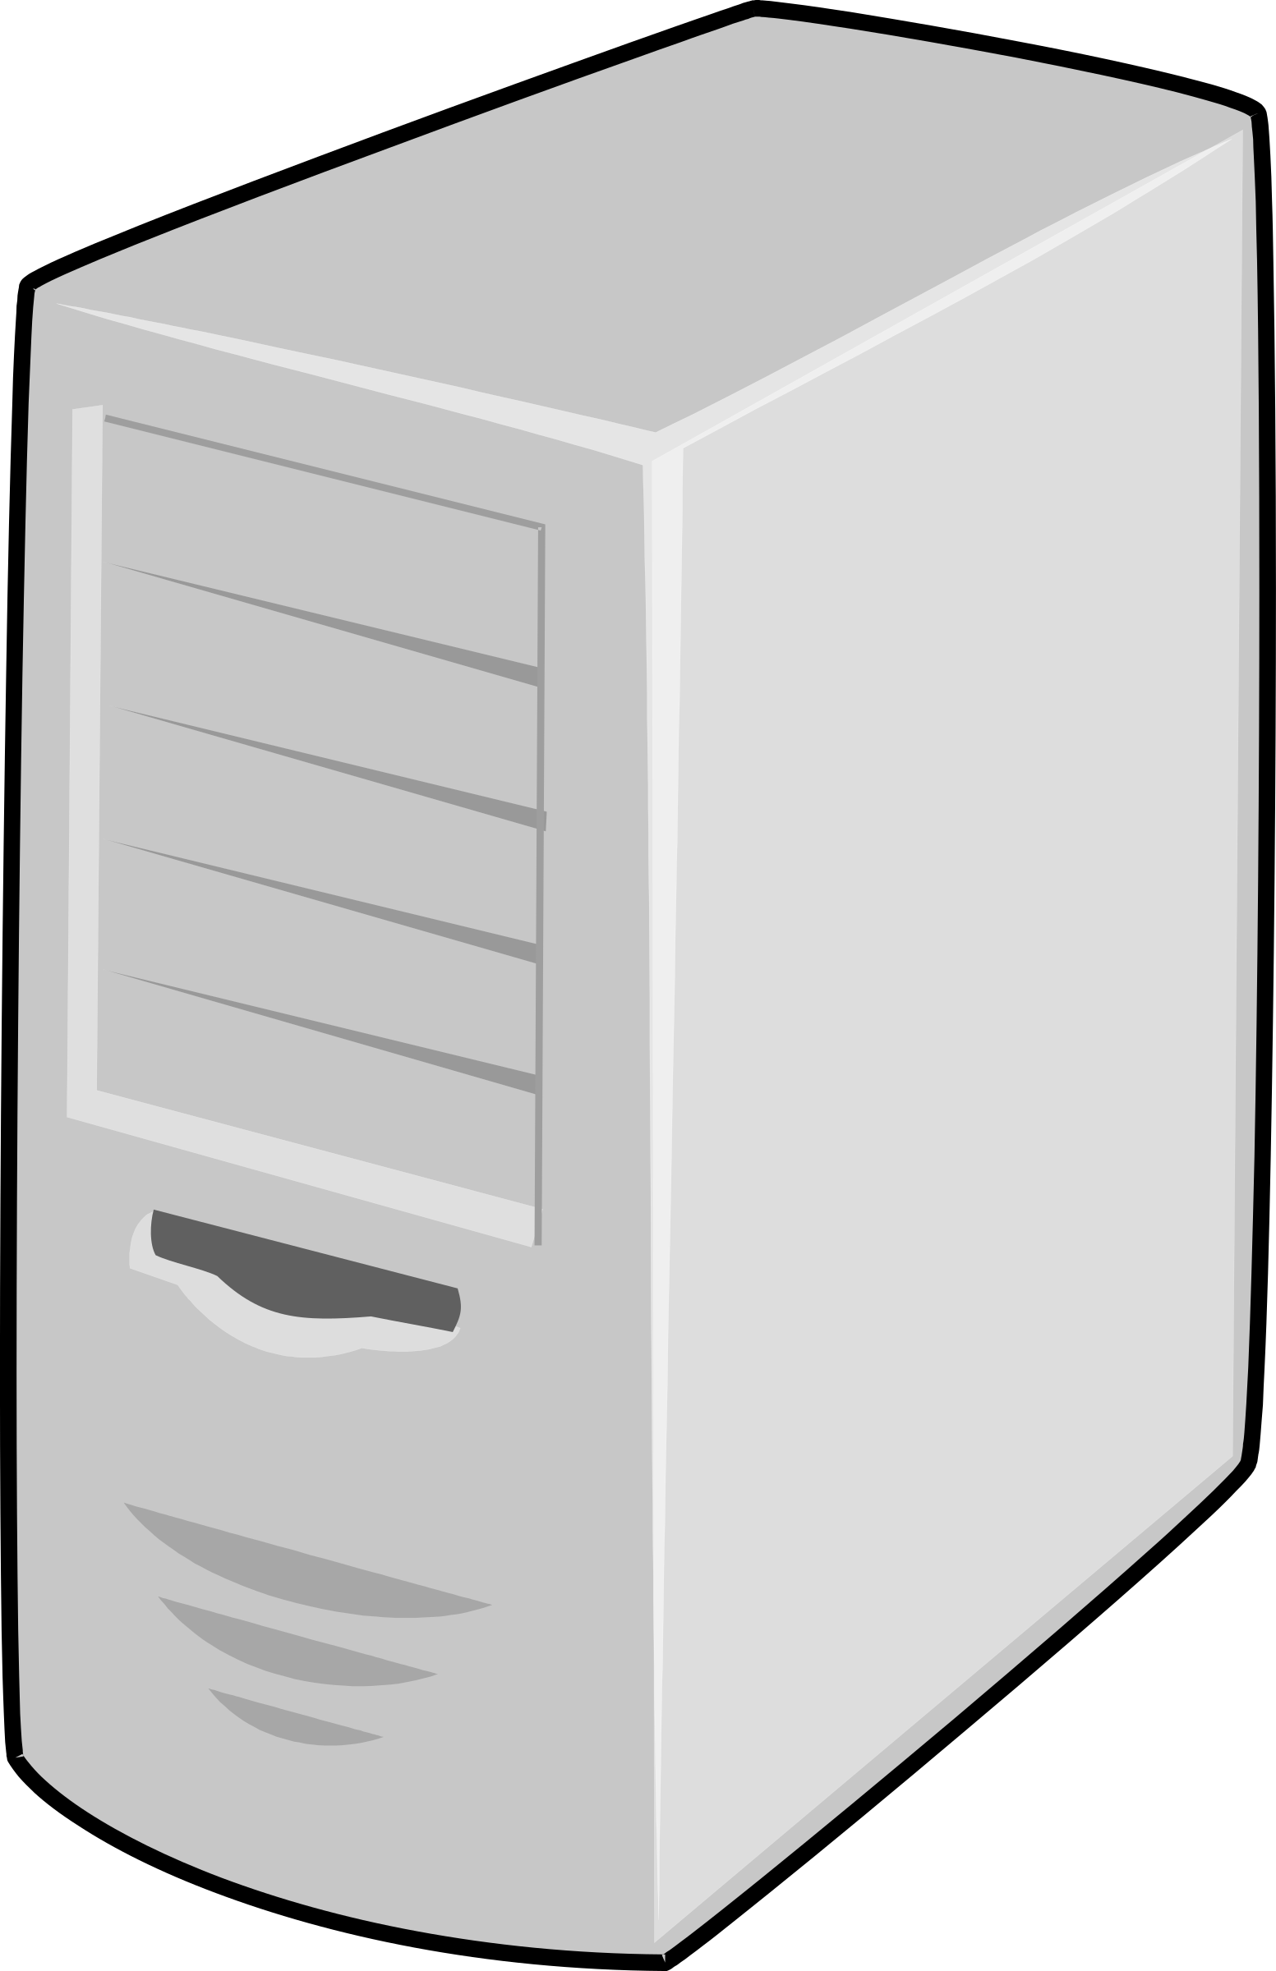
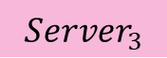
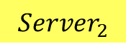
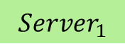
Communication in DS: Remote Procedure Call
How can these distributed servers communicate with each other?
$${Server}_{2}$$
$${Server}_{3}$$
$${Server}_{1}$$
Solution
Remote Procedure Call /Subroutine Call/ Function Call

Slide 29
Communication in DS: Remote Procedure Call
*Remote Procedure Call (RPC)
Remote Procedure Call is a software communication protocol that one program can use to request a service from a program located in another computer on a network without having to understand the network's details.
*Characteristics
RPC uses Client/Server model.
RPC is a synchronous operation.
The use of lightweight processes or threads that share the same address space enables multiple RPCs to be performed concurrently.

Slide 30
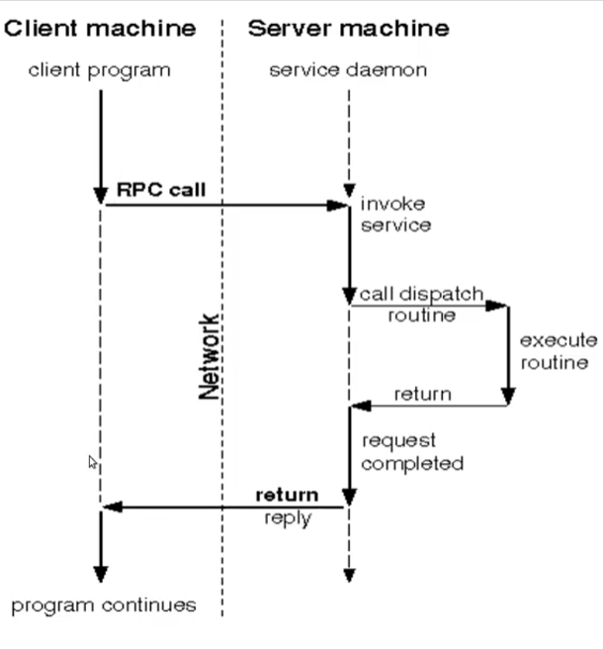
Communication in DS: Remote Procedure Call

Slide 31
Communication in DS: Remote Procedure Call
*Semantic of RPC
At least once: a message is resent several times and an answer is expected. The server may end up executing a request more than once, but an answer may never be received. These semantics are suitable for operations free of side effects.
At most once: a message is acted on at most once. The sender sets up a time-out for receiving the response; when the time-out expires, an error code is delivered to the caller. These semantics require the sender to keep a history of the time stamps of all messages because messages may arrive out of order. These semantics are suitable for operations that have side effects.
Exactly once: it implements the at most once semantics and requests an acknowledgment from the server.

Slide 32
Distributed System Architecture: Styles

Slide 33
Distributed System Architecture: Overview
Logical organization
Physical organization
S/W components
H/W components
* Characteristics:
Replaceable components with well-defined.
The way to exchange data between distributed components.
The way that components are connected to each other.
Hot add resources/ cool remove resources
S.W= Loosely coupling (reduce dependency).
H.W= Tightly coupling (increase speed, improve real-time processing)

Slide 34
Distributed System Architecture: Styles
Distributed System Architecture
1
Layered Style
2
Object-based Style
3
Resource-based Style
4
Publish-Subscribe Style

Slide 35
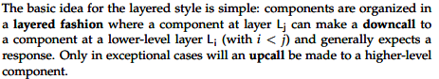
Distributed System Architecture: Styles
1- Layered Style:

Slide 36
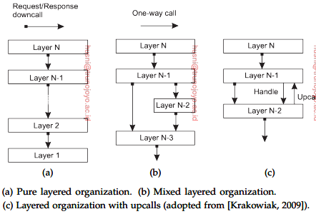
Distributed System Architecture: Styles
1- Layered Style:

Slide 37
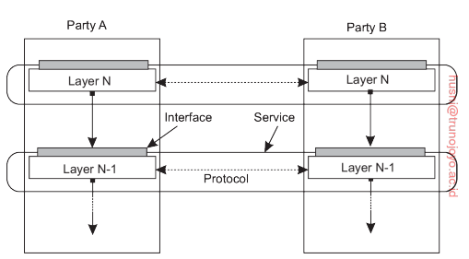
Distributed System Architecture: Styles
1- Layered Style:
Traditional Three-Layered Architecture:
Application layer: contains units for interfacing to user or external application.
Processing layer: contains the functions of an application.
Data layer: contains the data that a client wants to manipulate through the application components.

Slide 38
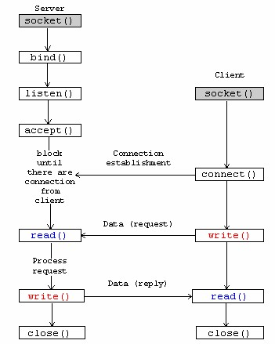
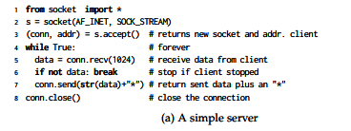
Distributed System Architecture: Styles
1- Layered Style:
Example 2:
Two communication parties:
Create TCP connection

Slide 39
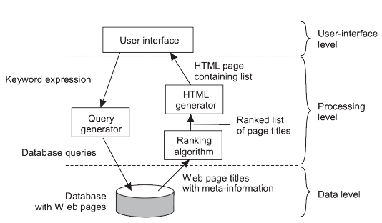
Distributed System Architecture: Styles
1- Layered Style:
Example 2: Search Engine

Slide 40
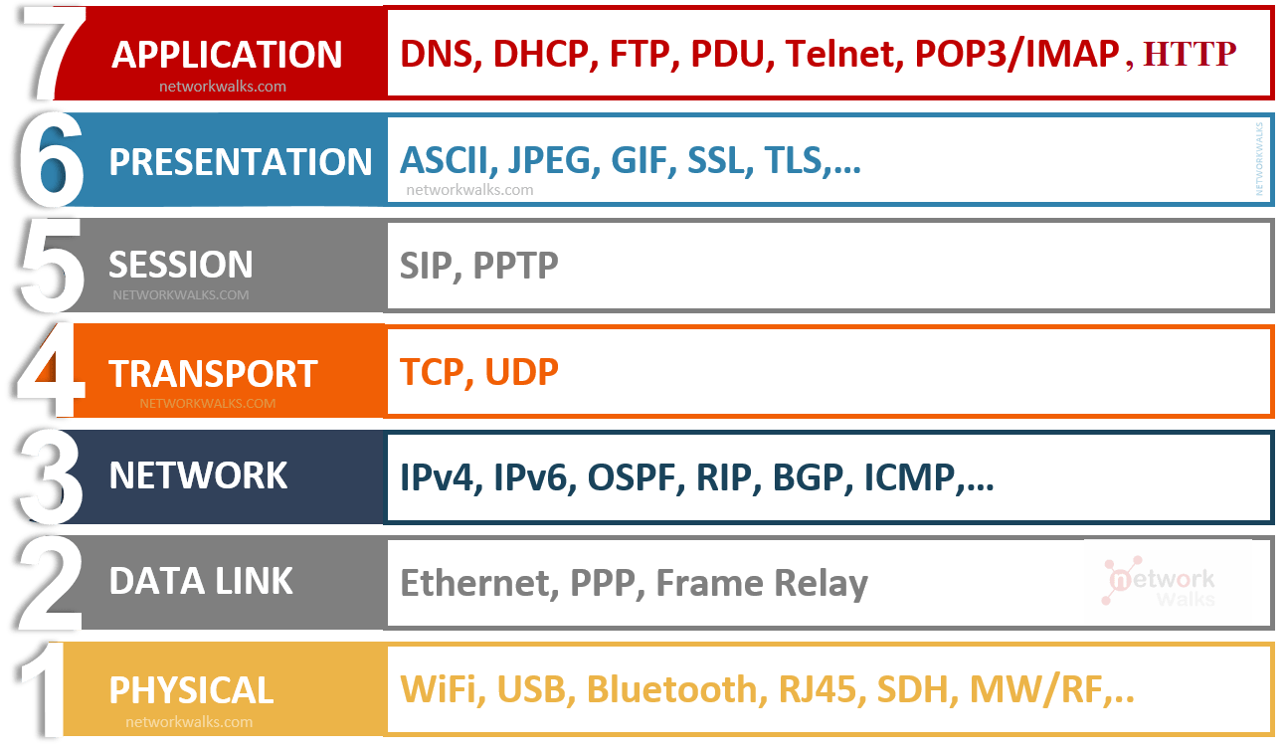
Distributed System Architecture: Styles
1- Layered Style:
Example 3: Reference Network Model

Slide 41
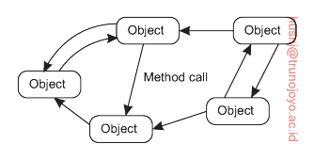
Distributed System Architecture: Styles
2-Object-based Style:
*Characteristics
All components are considered as an object.
Objects are loosely coupling organization (overcoming dependency).
Connection between these objects through RPC (called method call).
Data is encapsulation (called object’s state).

Slide 42
Distributed System Architecture: Styles
3-Resource-based Style:
This type of architecture is shown as a result of increasing Web Pages and users’ demands of service composition.
One of the definitions of DS. is a huge collection of resources that are individually managed by a set of components. These resources may be added or removed by remote applications. This approach is called Representation State Transfer (REST).

Slide 43
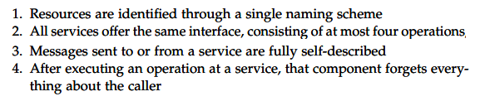
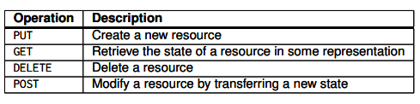
Distributed System Architecture: Styles
3-Resource-based Style:
*Characteristics of RESTful Architecture:
This execution called Stateless Execution.
An good example of RESTful Arch is Amazon’s S3

Slide 44
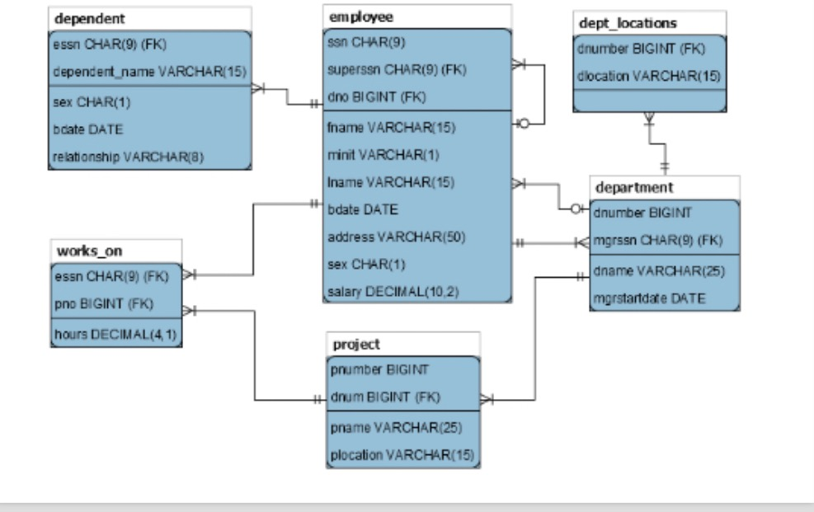
Distributed System Architecture: Styles
3-Resource-based Style:
Example of the schema

Slide 45
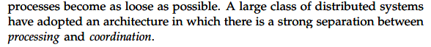
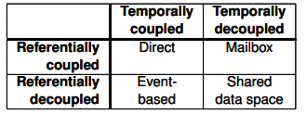
Distributed System Architecture: Styles
4- Publish-Subscribe Style:
Related to communication between components.
Related to collaborate between distributed components.
Types of coordination forms.

Slide 46
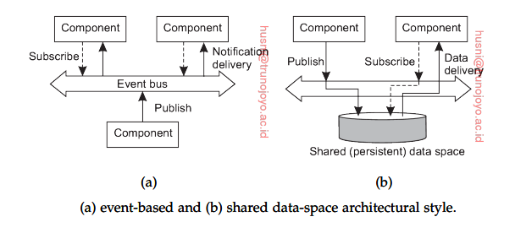
Distributed System Architecture: Styles
4- Publish-Subscribe Style:
*Benefits:
Increase reliability
Improve scalability

Slide 47
Reference
[1] Distributed Systems - Third edition - version 3.03 (2020) - Maarten van Steen - Andrew S. Tanenbaum

Slide 48
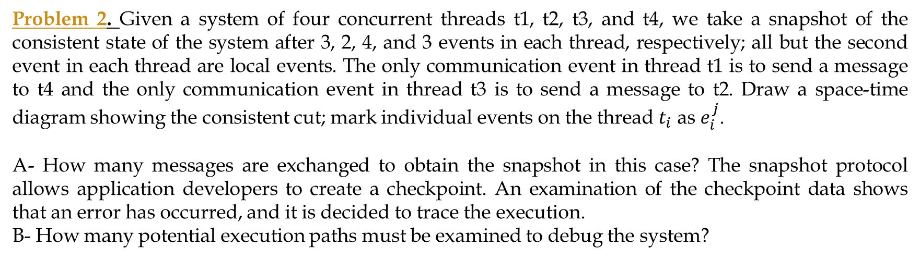
Activities
Problem 2. Given a system of four concurrent threads t1, t2, t3, and t4, we take a snapshot of the consistent state of the system after 3, 2, 4, and 3 events in each thread, respectively; all but the second event in each thread are local events. The only communication event in thread t1 is to send a message to t4 and the only communication event in thread t3 is to send a message to t2. Draw a space-time diagram showing the consistent cut; mark individual events on the thread $t_{i}$ as $e_{i}^{j}$.
A- How many messages are exchanged to obtain the snapshot in this case? The snapshot protocol allows application developers to create a checkpoint. An examination of the checkpoint data shows that an error has occurred, and it is decided to trace the execution.
B- How many potential execution paths must be examined to debug the system?
Problem 6. Explain briefly how the publish/subscribe paradigm works and discuss its application to
services such as bulletin boards, mailing lists, and so on. Outline the design of an event service based on this paradigm, as in Figure 2.21(b). Can you identify a cloud service that emulates an event service?

Slide 49
Thank You

